Slide 1


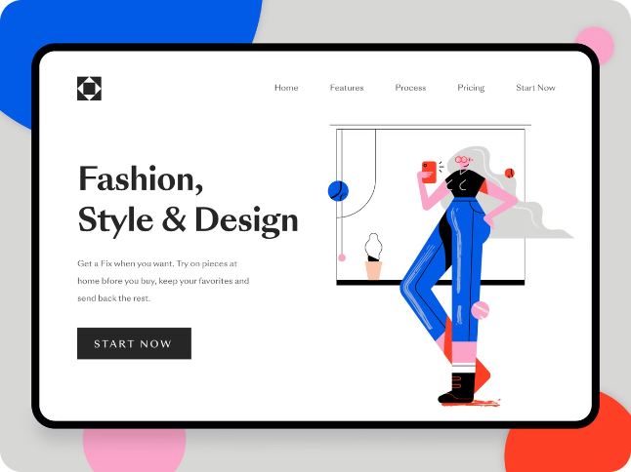
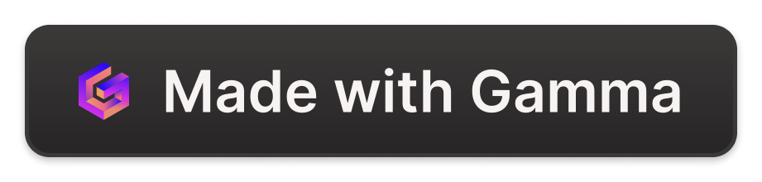
Fashion Setup Online Website
Launching a fashion website is a huge endeavor. This presentation will explore the features and benefits of a user-friendly, customizable, and secure online platform to showcase your fashion designs to the world.
pT
by pushyami & Thoshitha

Slide 2

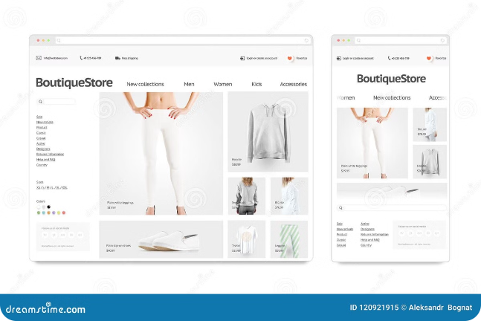
Key Features of the Website
1
User-Friendly Interface
2
Product Customization
Customers can personalize products, choosing colors, sizes, and other options to create unique pieces.
Easy navigation, intuitive search, and a streamlined checkout process ensure a smooth customer experience.
3
Secure Payment Gateway
4
Responsive Design
The website seamlessly adapts to different screen sizes, providing an optimal viewing experience on desktops, tablets, and smartphones.
A reliable and secure payment system provides peace of mind for customers and protects sensitive financial data.

Slide 3
Customizable Fashion Collections
Product Catalog
Collection Management
Seasonal Updates
Organize and showcase your collections with clear product categories, detailed descriptions, and high-quality images.
Create, edit, and manage your collections with ease. Add new items, update details, and control product visibility.
Stay ahead of the trends by easily adding new collections and updating existing ones to reflect seasonal changes.

Slide 4
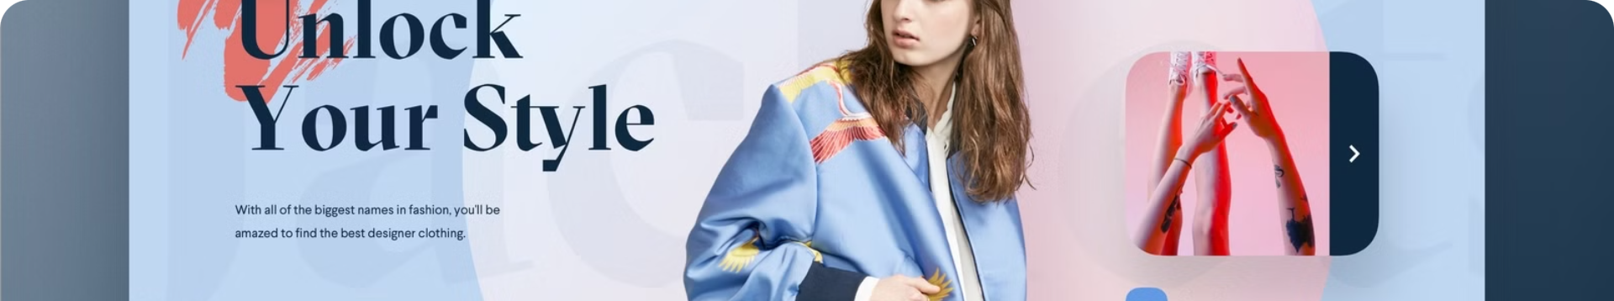



Intuitive User Interface
Homepage
Product Pages
Checkout Process
A visually appealing homepage showcasing your latest collections, featured products, and relevant news.
Detailed product pages with high-resolution images, comprehensive descriptions, size charts, and customer reviews.
A seamless checkout process with secure payment options, order tracking, and shipping information.

Slide 5
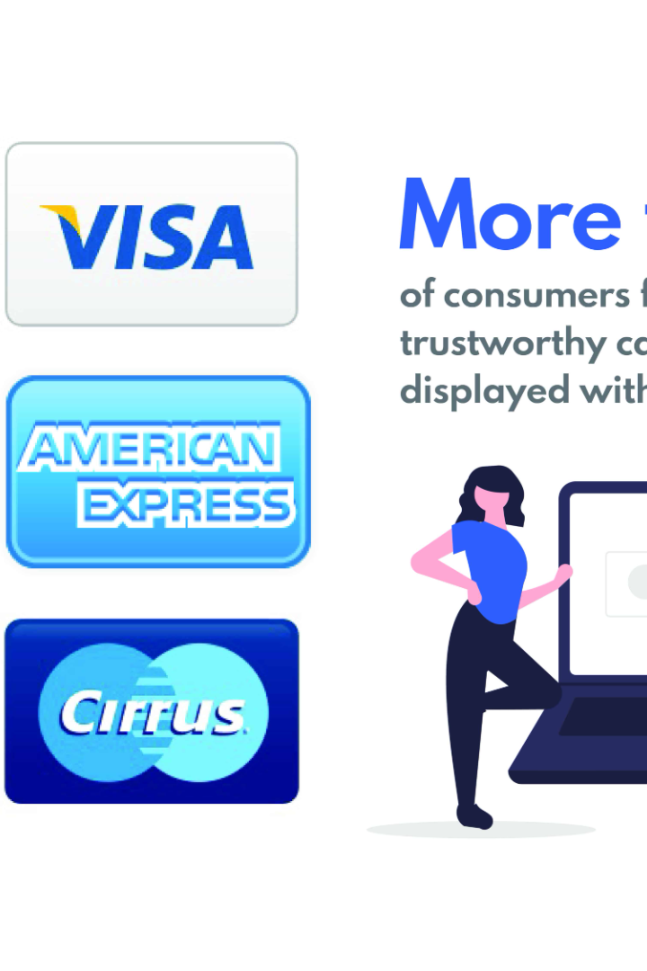
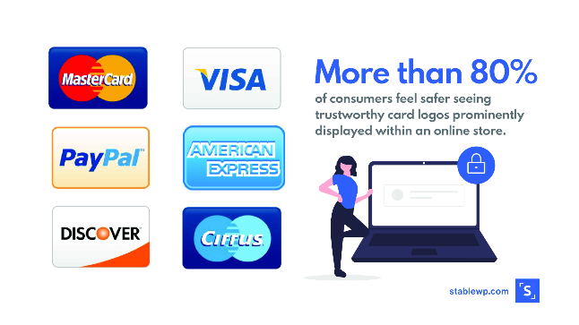
Secure and Reliable Checkout Process
Payment Gateways
Integration with trusted payment processors ensures secure transactions.
SSL Encryption
Protection of sensitive data with SSL certificates for secure communication.
Fraud Detection
Built-in fraud detection systems minimize the risk of unauthorized transactions.

Slide 6
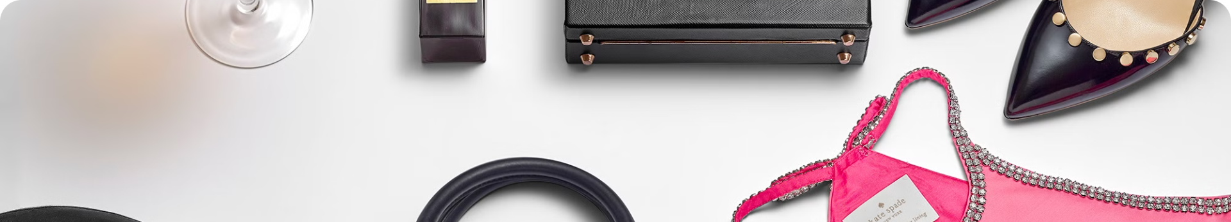
Detailed Product Descriptions and Images
High-Quality Images
Detailed Descriptions
Professional photography showcasing the details and textures of your clothing.
Comprehensive descriptions that highlight features, materials, and care instructions.
Size Charts
Customer Reviews
Accurate size charts to help customers choose the right fit for their needs.
Authentic customer reviews provide valuable insights and build trust with potential buyers.

Slide 7

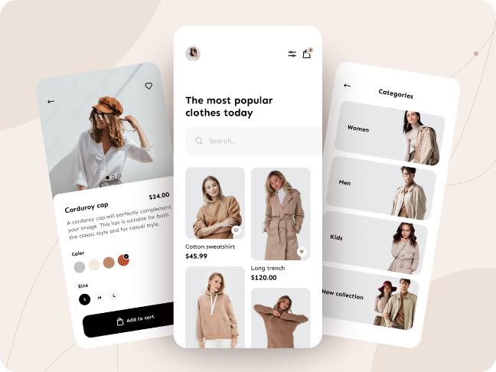
Responsive Design for Mobile and Desktop
1
Seamless Experience
The website adapts to different screen sizes, providing a consistent and intuitive experience across devices.
2
Enhanced Navigation
Easy navigation with optimized menus and touch-friendly controls for mobile devices.
3
Optimized Images
Image loading times are optimized for faster page loading on mobile devices.

Slide 8


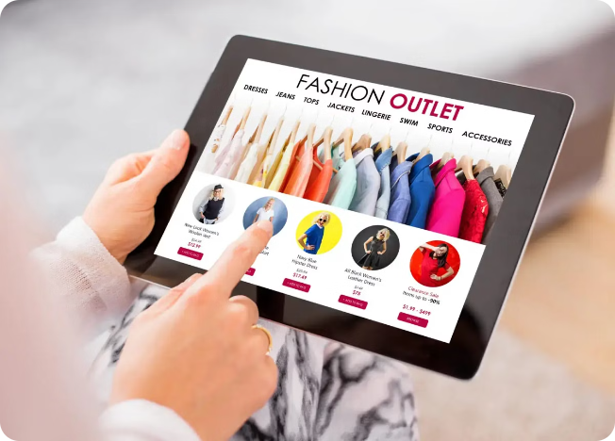


Conclusion and Call to Action
Reach a Wider Audience
Expand your reach and connect with fashion-conscious customers worldwide.
Boost Brand Visibility
Increase brand awareness and build a strong online presence.
Drive Sales and Revenue
Generate leads, convert customers, and grow your business.

